Slide 1


R. GLENN
HUBBARD
ANTHONY PATRICK
O’BRIEN
FIFTH EDITION
© 2015 Pearson Education, Inc.

Slide 2
The International
Financial System

Slide 3
Exchange Rate Systems
19.1
Describe how different exchange rate systems operate.

Slide 4
How are exchange rates determined?
In the previous chapter, we assumed exchange rates were determined by the market.
A floating currency is the outcome of a country allowing its currency’s exchange rate to be determined by demand and supply.
But allowing the relative values of currencies to be determined by demand and supply is just one type of exchange rate system, or agreement among countries about how exchange rates should be determined.
The present-day exchange rate system is best described as a managed float exchange system, under which the value of most currencies is determined by demand and supply, with occasional government intervention.

Slide 5
Fixed exchange rate systems
A fixed exchange rate system is one under which countries agree to keep the exchange rates among their currencies fixed for long periods.
From the 19th century until the 1930s, countries’ currencies were redeemable for fixed amounts of gold—a system known as the gold standard. The amount of gold each for which currency was redeemable determined the exchange rates.
After the Great Depression of the 1930s, most countries abandoned the gold standard. In 1944, a conference in Bretton Woods, NH established the Bretton Woods system:
The U.S. pledged to buy or sell gold at $US 35 per ounce
Other member countries agreed to a fixed exchange rate between their currency and the U.S. dollar
We will examine these systems further in this chapter’s appendix.

Slide 6
The Current Exchange Rate System
19.2
Discuss the three key features of the current exchange rate system.

Slide 7
Highlights of the current exchange rate system
The current exchange rate system has three important aspects:
The U.S. allows the dollar to float against other major currencies.
Seventeen countries in Europe have adopted a single European currency, the euro.
Some countries have attempted to keep their currencies’ exchange rates fixed against the $US or some other currency.
Each of these aspects has important consequences, and we will examine them in turn.

Slide 8
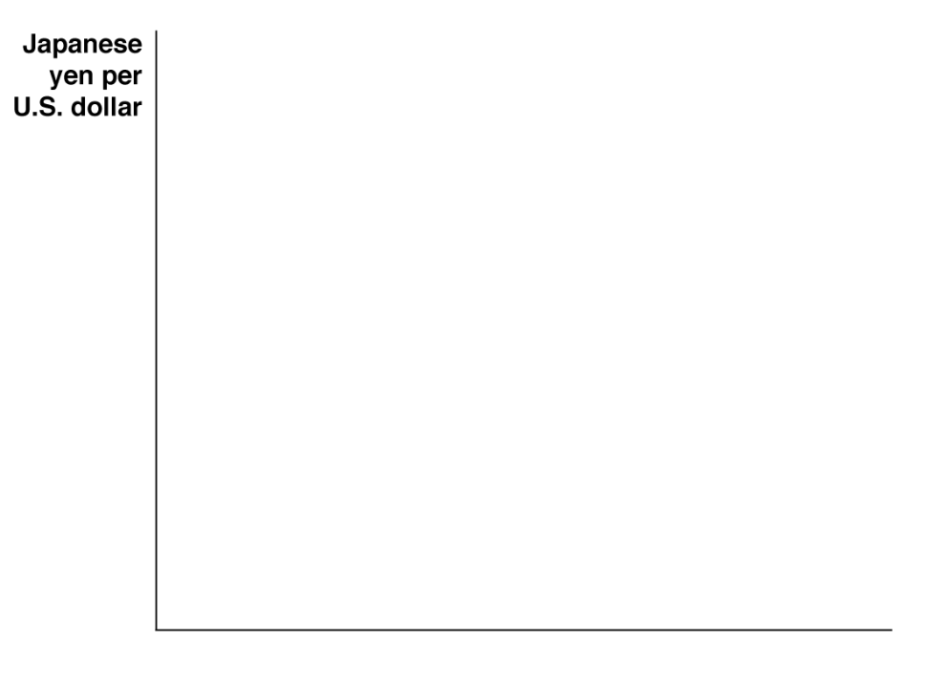

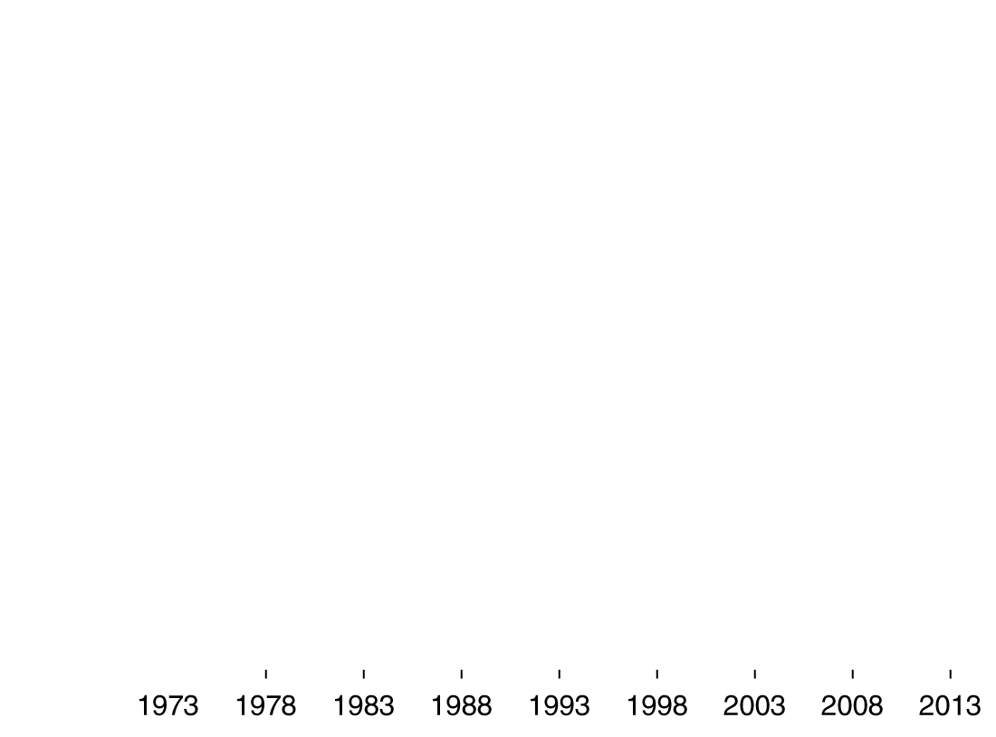
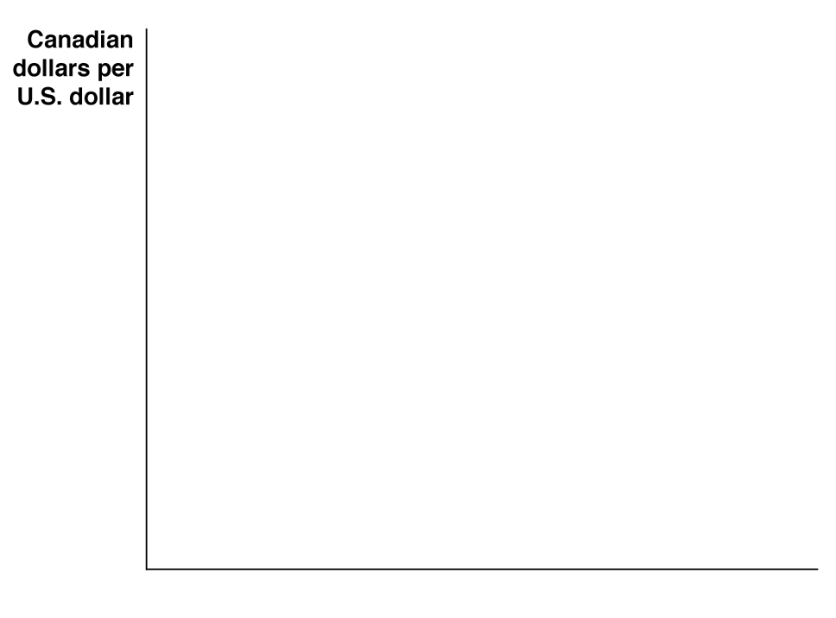
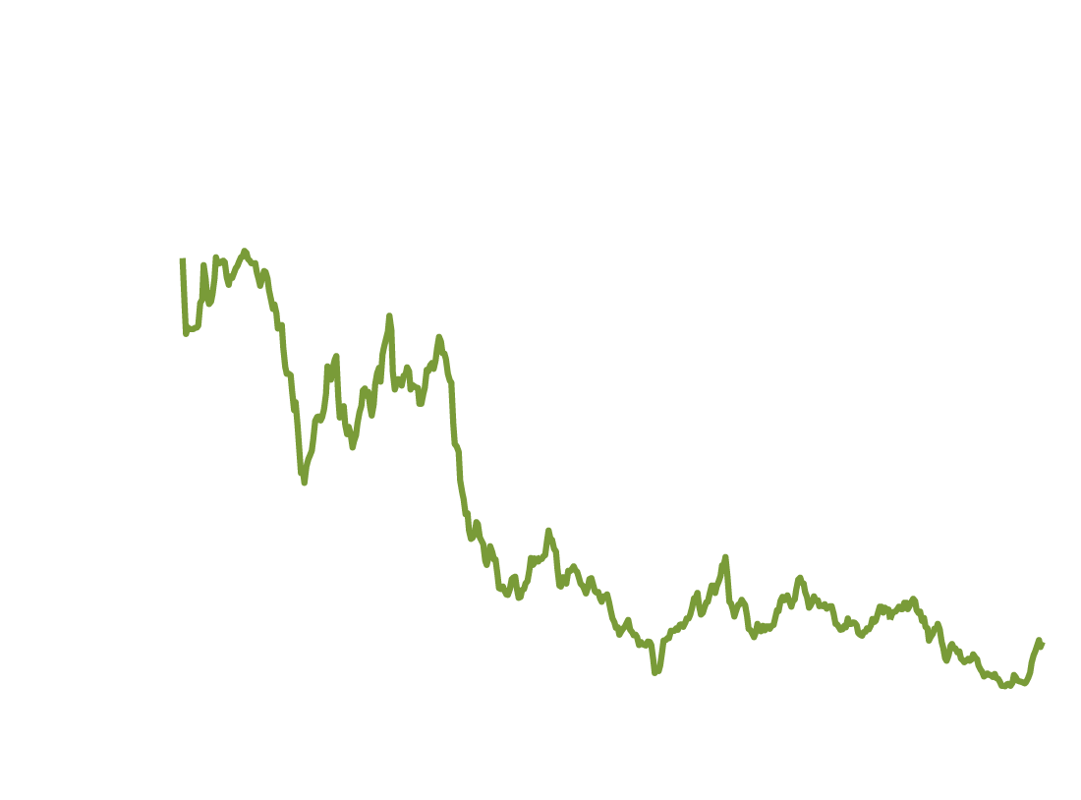
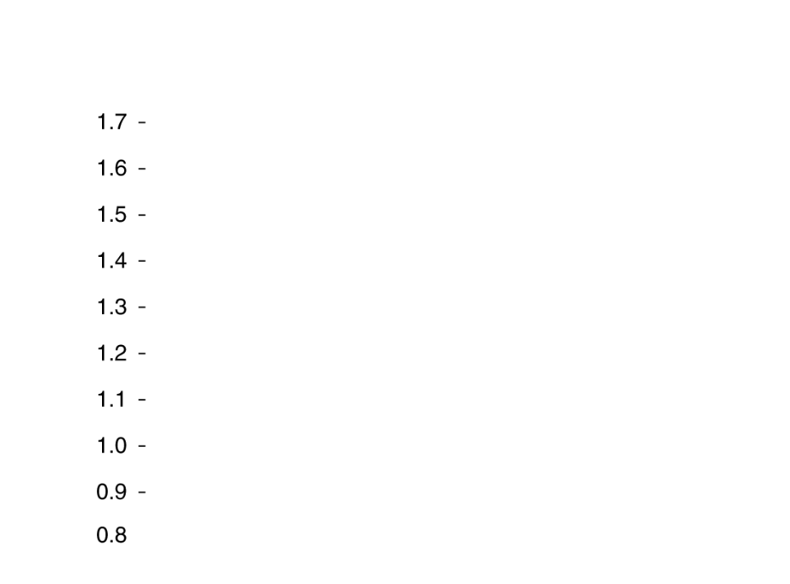
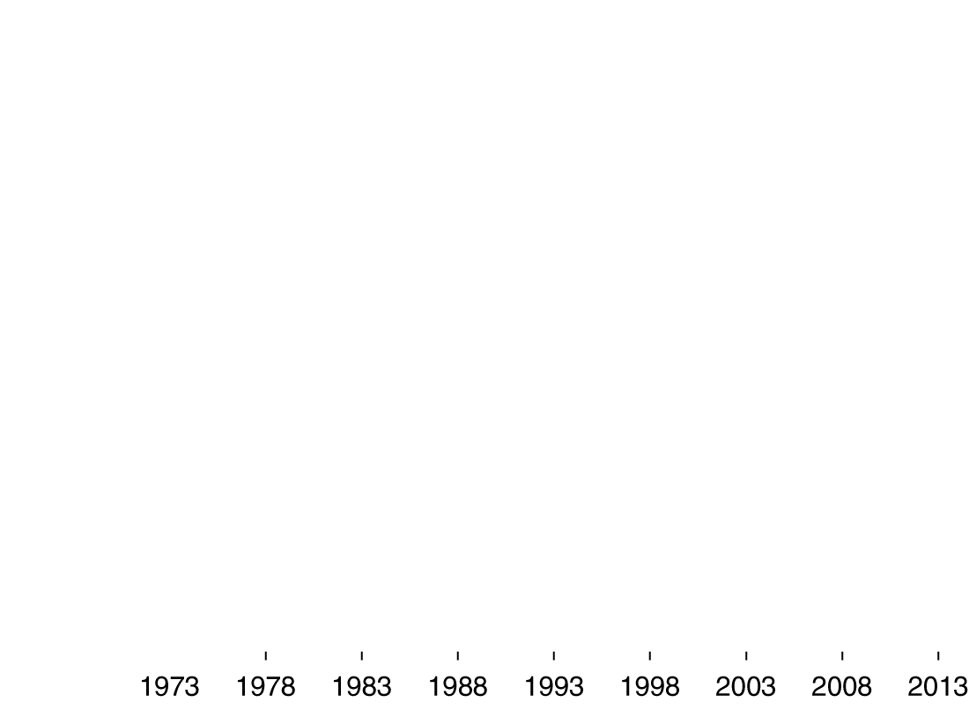
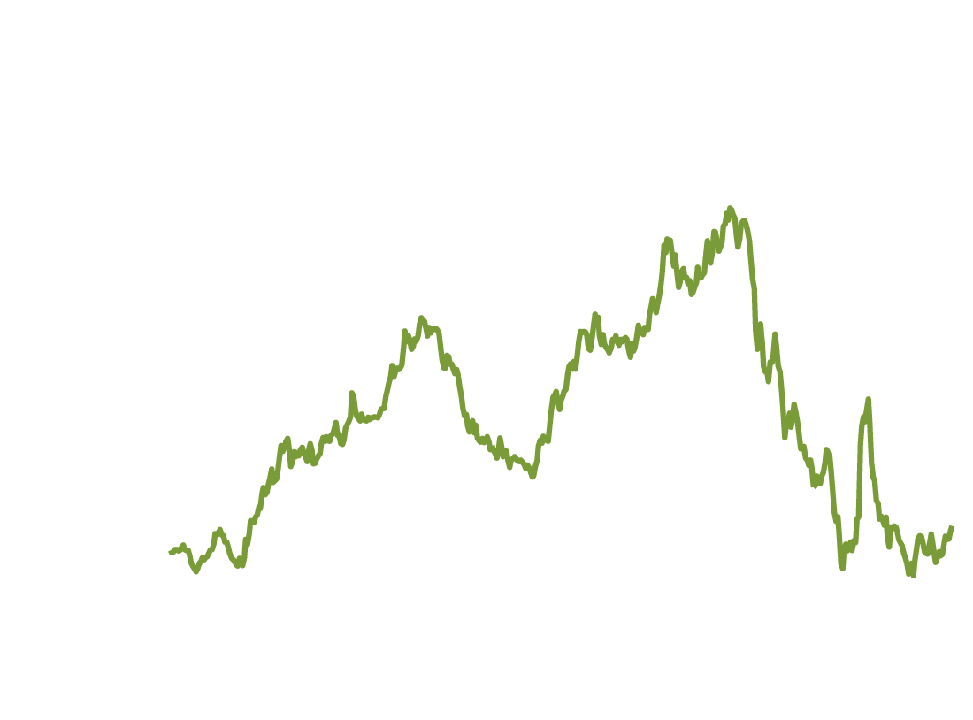
1. The floating dollar
Figure 19.1
Canadian dollar-U.S. dollar and Yen-U.S. dollar exchange rates, 1973-2013
The Bretton Woods system of fixed exchange rates ended in 1973. Since then the value of the $US (in terms of how many units of foreign currency one U.S. dollar can buy) has floated.
One U.S. dollar buys about as many Canadian dollars as it did in 1973.
But it only buys about a third as many Japanese yen.
Notes:
Panel (a) shows that from the end of the Bretton Woods system in 1973 through August 2013, the U.S. dollar gained slightly in value against the Canadian dollar. Panel
(b) shows that during the same period, the U.S. dollar lost about two-thirds of its value against the Japanese yen.
Source: Federal Reserve Bank of St Louis.

Slide 9
What determines exchange rates in the long run?
Why has the value of the U.S. dollar fallen so much against the Japanese yen, and yet risen then fallen to about the original level against the Canadian dollar?
In the short run, the two most important influences on exchange rates are:
Relative interest rates
Expectations about future values of currencies
But over the long run, it seems reasonable that exchange rates should move to equalize the purchasing powers of different currencies. This is known as the theory of purchasing power parity.

Slide 10
Purchasing power parity
Suppose that candy bars sell for £2 in the United Kingdom, and for $1 in the United States.
If the exchange rate were £1 = $1, then a clever entrepreneur could:
Buy a million candy bars in the U.S. for $1,000,000
Transport them to the U.K, and sell them for £2,000,000
Exchange that currency for $2,000,000: a profit of $1,000,000, minus the cost of shipping.
If many people did this, there would be an increase in the supply of British pounds, offered to purchase U.S. dollars; so we would expect the exchange rate to appreciate.
If it appreciated to £2 = $1, currency would have equal purchasing power in each location, and there would be no more pressure on the exchange rate to change.

Slide 11
What stops purchasing power parity from occurring?
When you travel, you will notice that some goods and services are cheaper overseas than here, and some are more expensive.
Why doesn’t purchasing power parity stop this from happening?
Not all products can be traded internationally (especially services).
Products and consumer preferences are different across countries; prices are determined by supply, but also by demand.
Countries impose barriers to trade, like tariffs (taxes on imports) and quotas (numerical limits on imports).
Example: the U.S. sugar quota ensures that purchasing power parity cannot reduce the price of sugar in the U.S. to the “world price”.

Slide 12

The Big Mac theory of exchange rates
The Economist magazine collects the prices of Big Macs in different countries.
In July 2011, the average price of a Big Mac was $4.56 in the United States.
Comparing this to the average prices of Big Macs in other countries offers a (light-hearted) test of purchasing power parity:
COUNTRY | BIG MAC PRICE | IMPLIED EXCHANGE RATE | ACTUAL EXCHANGE RATE
Mexico | 37 pesos | 8.11 pesos per dollar | 12.94 pesos per dollar
Japan | 320 yen | 70.18 yen per dollar | 100.11 yen per dollar
United Kingdom | 2.69 pounds | 0.59 pound per dollar | 0.67 pound per dollar
Switzerland | 6.5 Swiss francs | 1.43 Swiss francs per dollar | 0.97 Swiss francs per dollar
Indonesia | 27,939 rupiahs | 6,127 rupiahs per dollar | 9,965 rupiahs per dollar
Canada | 5.53 Canadian dollars | 1.21 Canadian dollars per U.S. dollar | 1.05 Canadian dollars per U.S. dollar
China | 16 yuan | 3.51 yuan per dollar | 6.13 yuan per dollar

Slide 13
Determinants of exchange rates in the long run—part 1
Relative price levels
Purchasing power parity explains some exchange rate movements.
Example: Prices in Japan have risen slower than prices in the U.S., helping to explain why the Japanese yen has appreciated in value relative to the U.S. dollar.
Relative rates of productivity growth
A country with relatively high productivity growth will have less expensive products; demand for these products from foreigners will cause the domestic currency to appreciate
Example: Japanese productivity rose faster than U.S productivity in the 1970s and 1980s, contributing to the depreciation of the U.S. dollar over that time.

Slide 14
Determinants of exchange rates in the long run—part 2
Preferences for domestic or foreign goods
If consumers in Canada increase their demand for U.S. goods, they increase their demand for U.S. dollars, and hence appreciate the value of the $US.
Tariffs and quotas
High tariffs or restrictive quotas reduce the demand for foreign goods, and hence cause the domestic currency to appreciate.

Slide 15
How do exchange rates affect firms?
An appreciation of the U.S. dollar makes imports cheaper for us to buy, but makes our exports more expensive for foreigners.
So importing firms tend to like it when the $US is valued more highly, and exporting firms tend to prefer it when the $US is relatively weaker.
But floating exchange rates also add an element of risk to foreign transactions, making it difficult for firms to make long-term plans involving foreign trade.
Markets do exist for buying future currency at current prices; but firms pay a premium for this risk-reduction.

Slide 16
2. The euro
In part to encourage international trade, 12 European countries decided to adopt a common currency—the euro—in 1999.
Their exchange rates of their currencies—the French franc, the Spanish peseta, the German mark, etc.—were permanently fixed against one another.
In 2002, the euro currency went into circulation, and the domestic currencies were withdrawn from circulation.
By 2013, 17 of the European Union nations had adopted the euro as their currency.
A new European Central Bank (ECB) was also established; the ECB became responsible for monetary policy throughout the Euro zone.

Slide 17
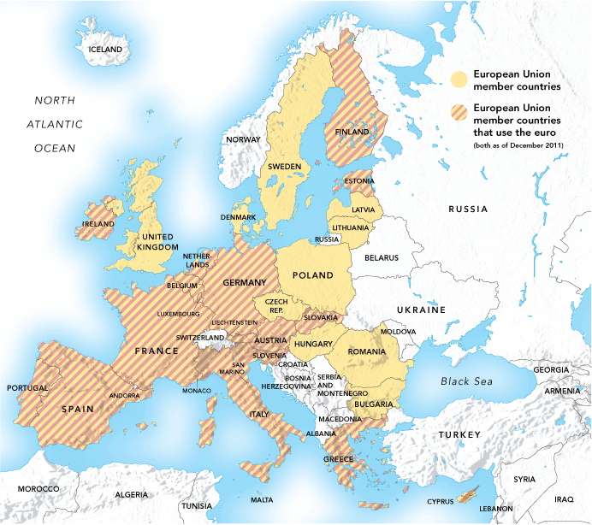
Countries adopting the euro
Yellow-shaded countries are members of the European Union.
Countries with red stripes have adopted the euro as their currency.
Figure 19.2
Countries adopting the euro
Notes:
The 17 member countries of the European
Union (EU) that have adopted the euro
as their common currency as of 2013 are
shaded with red hash marks. The members
of the EU that have not adopted the euro
are colored tan. Countries in white are not
members of the EU.

Slide 18

Can the euro survive?
For the first few years of the Euro, all seemed well: relative economic stability through most of Europe, expanding employment and production, and easier foreign transactions for firms and consumers.
But the recession of 2007-2009 hit Europe as well, and a weakness of the shared currency became apparent: individual countries using the euro could not pursue their own monetary policies.
The inability to use monetary policy was one of the reasons countries abandoned the gold standard.
The countries could and did use expansionary fiscal policy; but the debts incurred lead to sovereign debt crises for several Euro zone nations.
Can the euro survive? No-one knows for sure.

Slide 19
3. Pegging against the dollar
Some developing countries have attempted to keep their exchange rates fixed against the $US or other currencies, an action known as pegging.
Advantages:
Easier planning for firms
A more credible commitment to fighting inflation
Disadvantages:
Needing to support an under- or over-valued currency
Potential for destabilizing speculation if speculators believe the currency will eventually appreciate or depreciate
Difficulty in pursuing an independent monetary policy

Slide 20
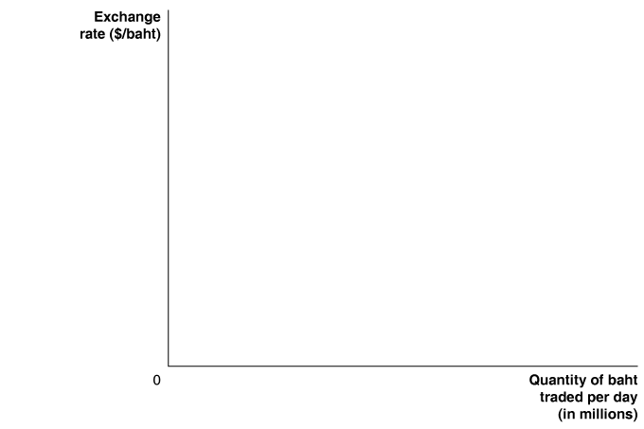

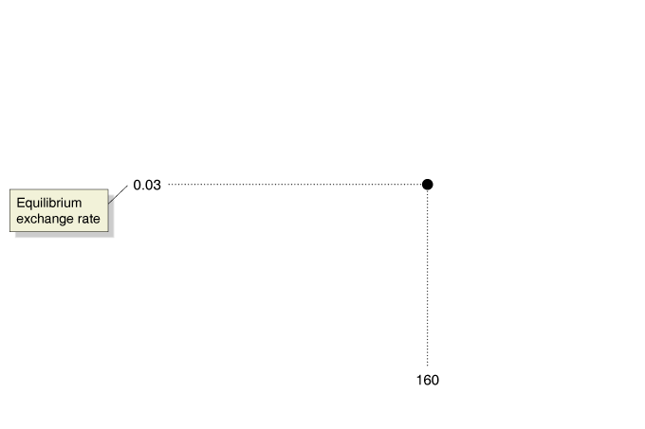
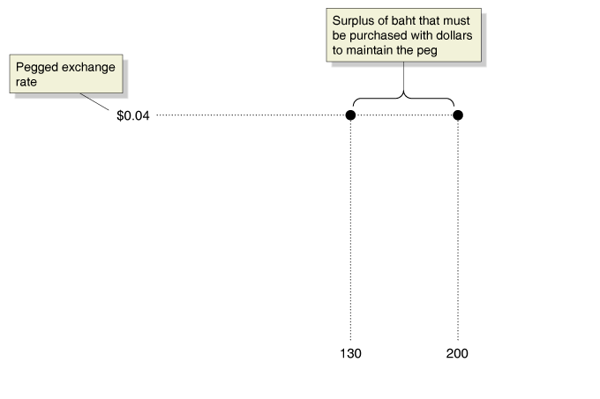
The East Asian exchange rate crisis of the late 1990s
In the 1990s, the Thai baht was pegged to the $US at a rate of 1 baht = $0.04.
But by 1997, the market equilibrium value of Thai baht was only $0.03.
Figure 19.3
By 1997, the Thai baht was overvalued against the dollar
This created a persistent surplus of Thai baht on foreign exchange markets. To support the pegged rate, the Bank of Thailand had to buy baht with its U.S. dollar reserves. It also raised Thai interest rates to attract investors; but that further depressed the Thai economy.
Notes:
The government of Thailand pegged the
value of the baht against the dollar to make
it easier for Thai firms to export to the
United States and to protect Thai firms that
had taken out dollar loans. The pegged exchange
rate of $0.04 per baht was well above
the equilibrium exchange rate of $0.03 per
baht. In the example in this figure, the overvalued
exchange rate created a surplus of
70 million baht, which the Thai central bank
had to purchase with dollars.

Slide 21
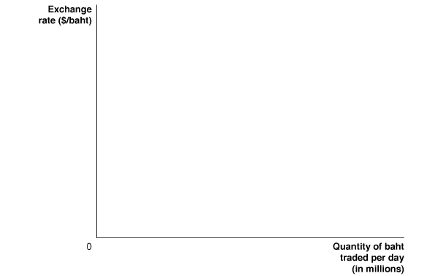
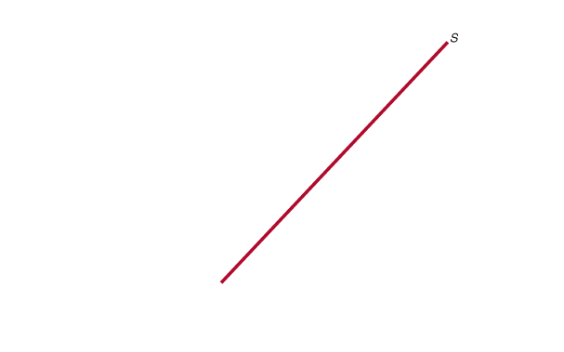

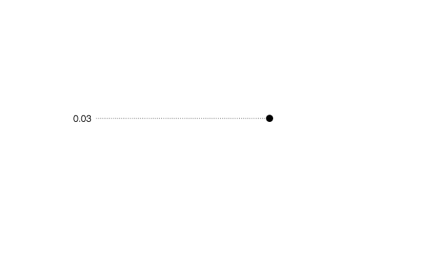
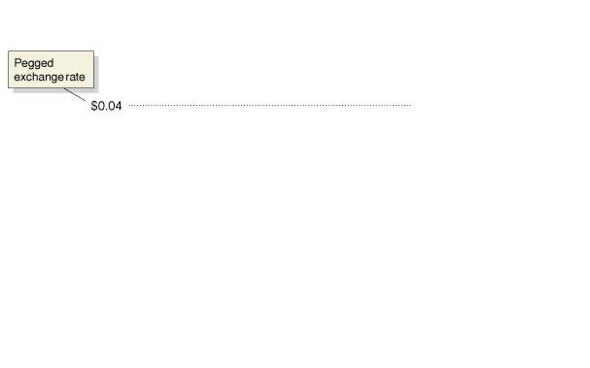
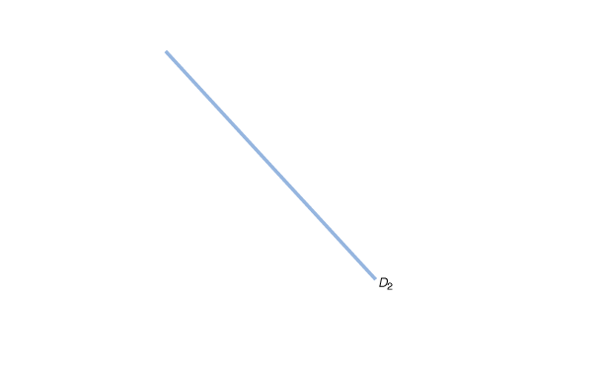
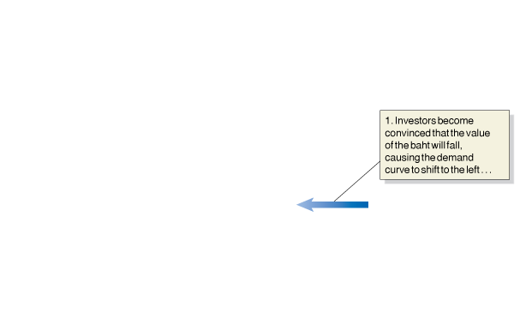
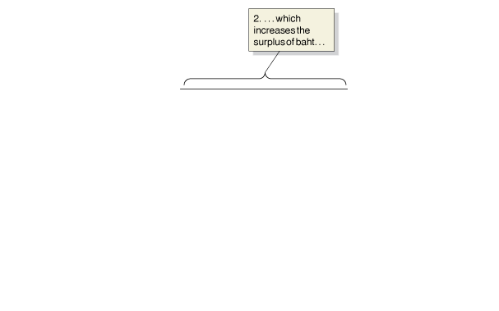
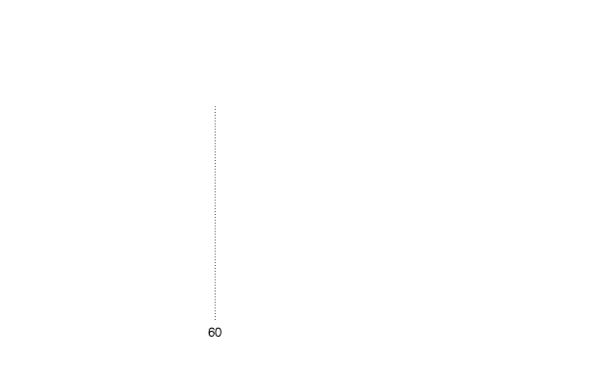
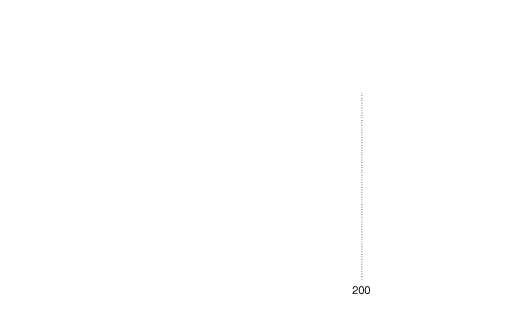
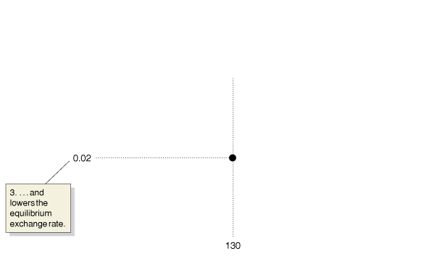
Destabilizing speculation against the baht
The Thai difficulties did not go unnoticed.
People believed that the Bank of Thailand would not be able to maintain the high value of its currency, so they sold off Thai currency as quickly as possible.
Figure 19.4
Destabilizing speculation against the baht
This further depressed the market equilibrium exchange rate, increasing the motivation to sell off Thai currency.
In July 1997 Thailand allowed its currency to float; but now firms had debt denominated in $US, and with their earnings in Thai baht, they found it even harder to repay their loans.
Many firms went bankrupt, leading to a deep Thai recession.
Notes:
In 1997, the pegged exchange rate of $0.04 =
1 baht was above the equilibrium exchange
rate of $0.03 = 1 baht. As investors became
convinced that Thailand would have to
abandon its pegged exchange rate against
the dollar and allow the value of the baht to
fall, they decreased their demand for baht,
causing the demand curve to shift from
D1 to D2. The new equilibrium exchange
rate became $0.02 = 1 baht. To defend the
pegged exchange rate, the Bank of Thailand
had to increase the quantity of baht it
purchased in exchange for dollars from 70
million to 140 million per day. The destabilizing
speculation by investors caused Thailand
to abandon its pegged exchange rate in
July 1997.

Slide 22
The decline in pegging
Several other East Asian countries experienced similar speculative attacks on their currencies—including South Korea, Indonesia, and Malaysia—leading them to abandon pegged exchange rates.
Today, many countries have followed this trend, allowing a managed float of their currencies instead.
Some countries maintain pegged exchange rates:
Several Caribbean countries peg against the $US
Several former French colonies in Africa pegged against the French franc, and now do against the euro
Most of these countries are small, and primarily trade with the country to whose currency they peg.

Slide 23
The Chinese experience with pegging
In 1994, China decided to peg its currency against the $US, at a rate of 8.28 yuan = $1. This brought predictability for Chinese firms trading with American firms.
By the early 2000s, many economists believed the yuan was undervalued. To maintain the pegged exchange rate, the Chinese bank bought large amounts of U.S. currency—more than $700 billion.
The undervalued yuan was good for Chinese exporters; but export-competing firms in the U.S., Japan, and Europe thought this was unfair, and their governments pressured China to allow its currency to float.

Slide 24
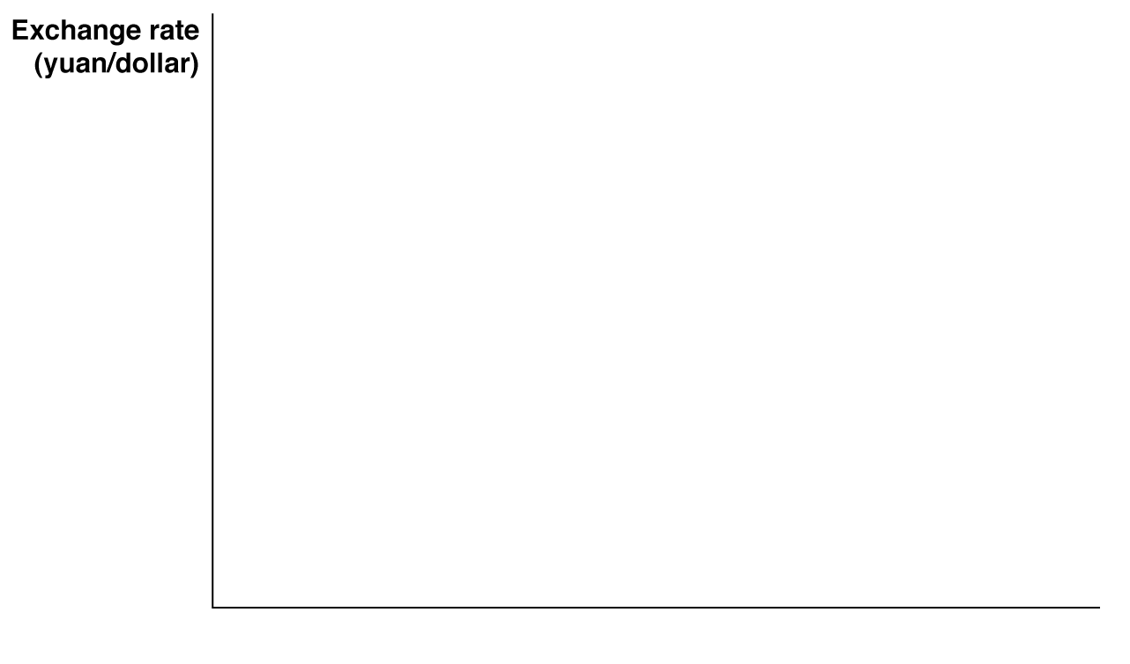

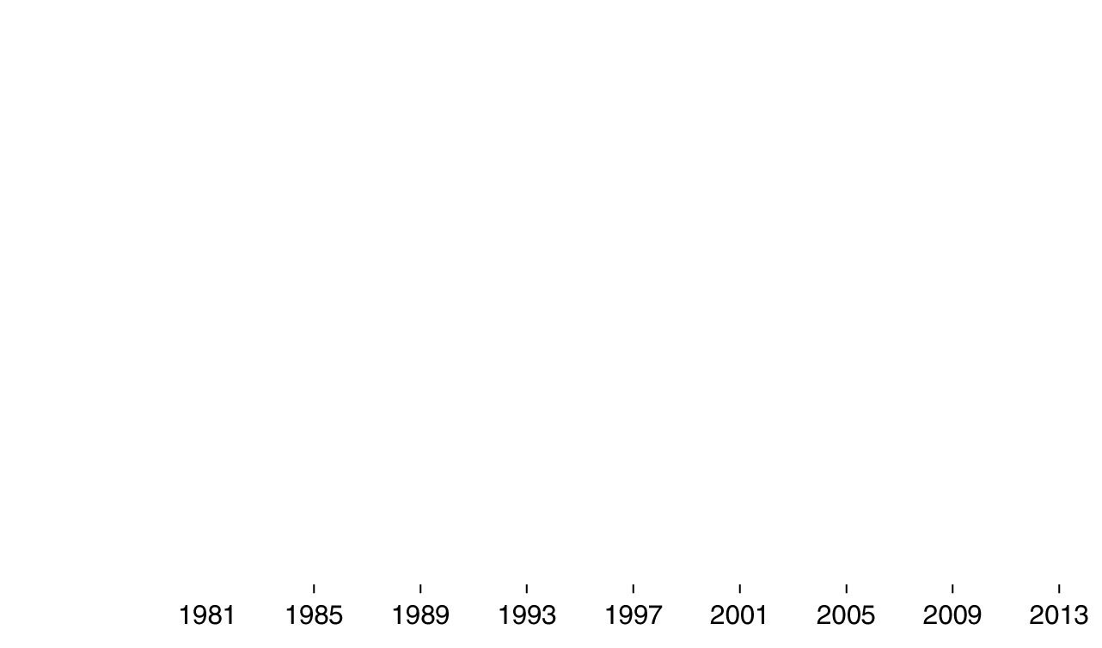
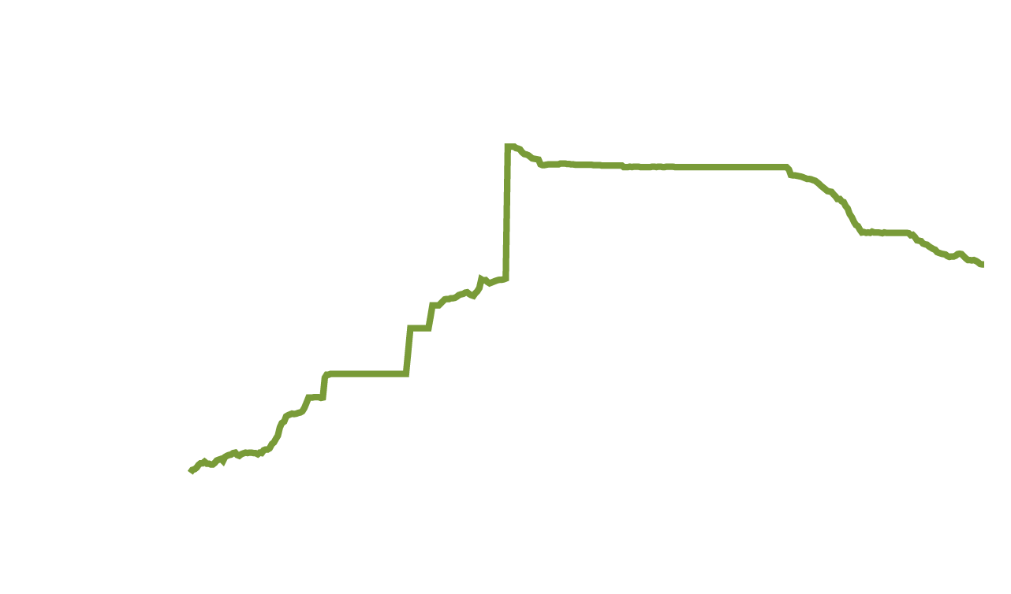
The yuan floats—maybe
In 2005, China
switched to linking the value of the yuan to a basket of currencies; then announced it was allowing a managed float of the yuan.
But many economists remain skeptical, since the exchange rate seems to move in too predictable a manner.
Figure 19.5
The yuan-dollar exchange rate
Is an over-valued yuan really so bad for Americans? It hurts export-competing firms; but import-consuming customers benefit from cheaper products.
Notes:
China began explicitly pegging the value
of the yuan to the dollar in 1994. Between
July 2005 and July 2008, China allowed the
value of the yuan to rise against the dollar
before returning to a hard peg at about 6.83
yuan to the dollar. In June 2010, the central
bank of China announced that it would
return to allowing the value of the yuan to
rise against the dollar, which it did slowly
through late 2013.
Source: Federal Reserve Bank of St. Louis.

Slide 25
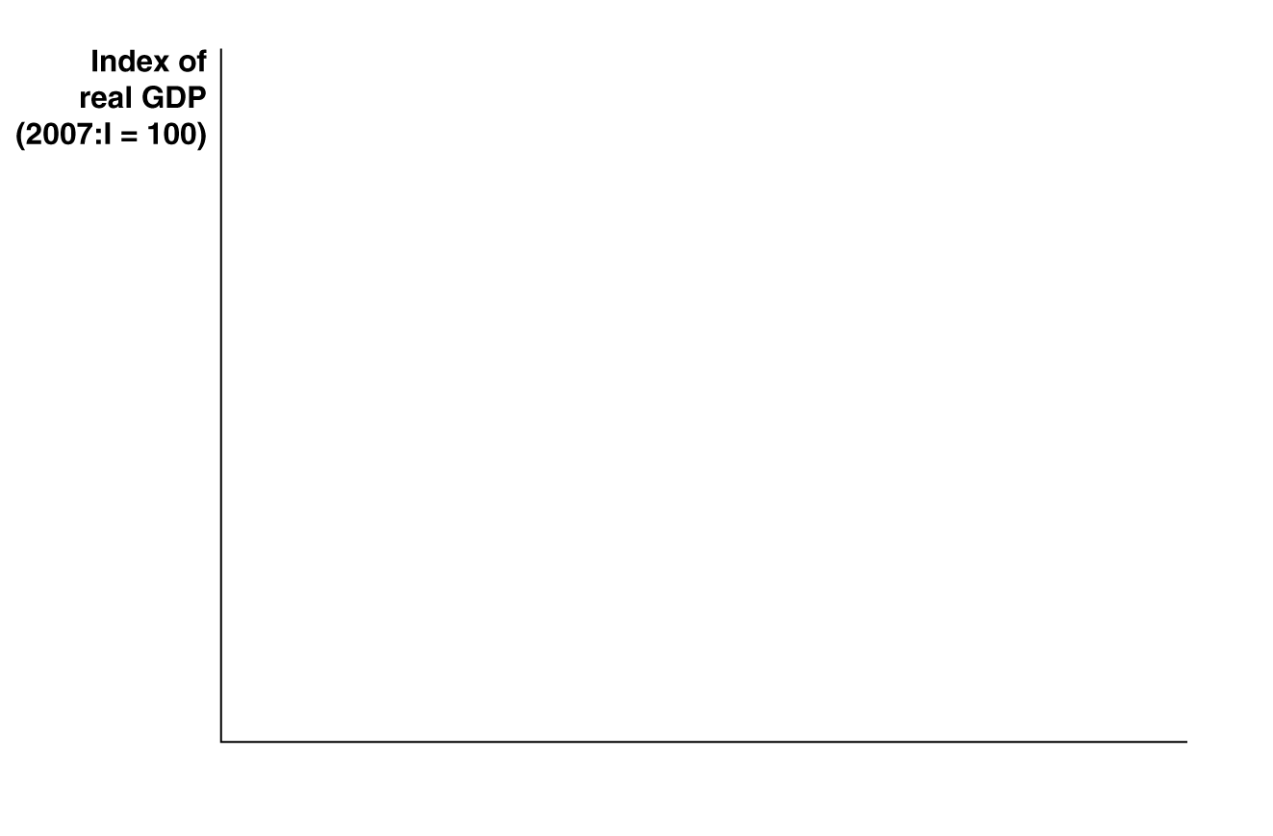

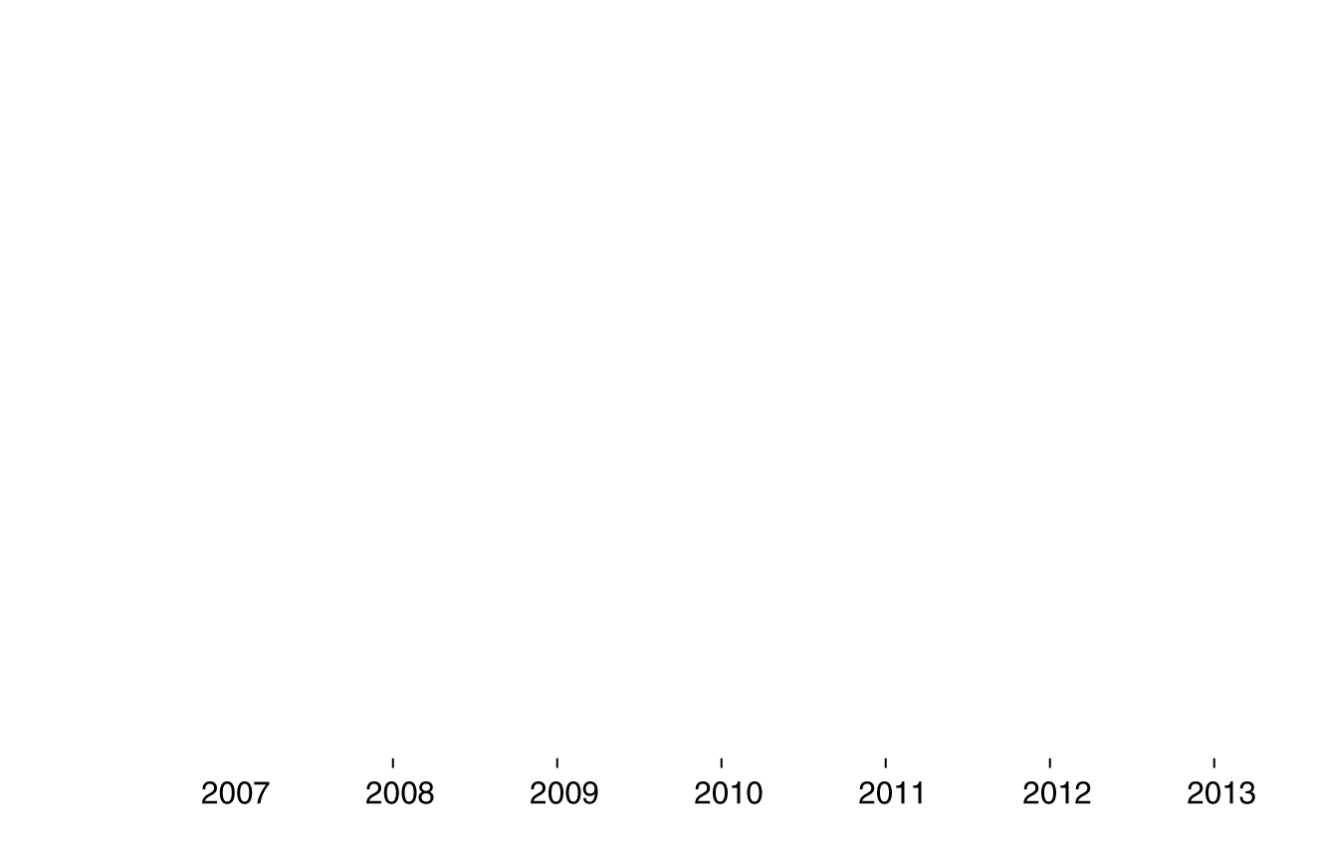
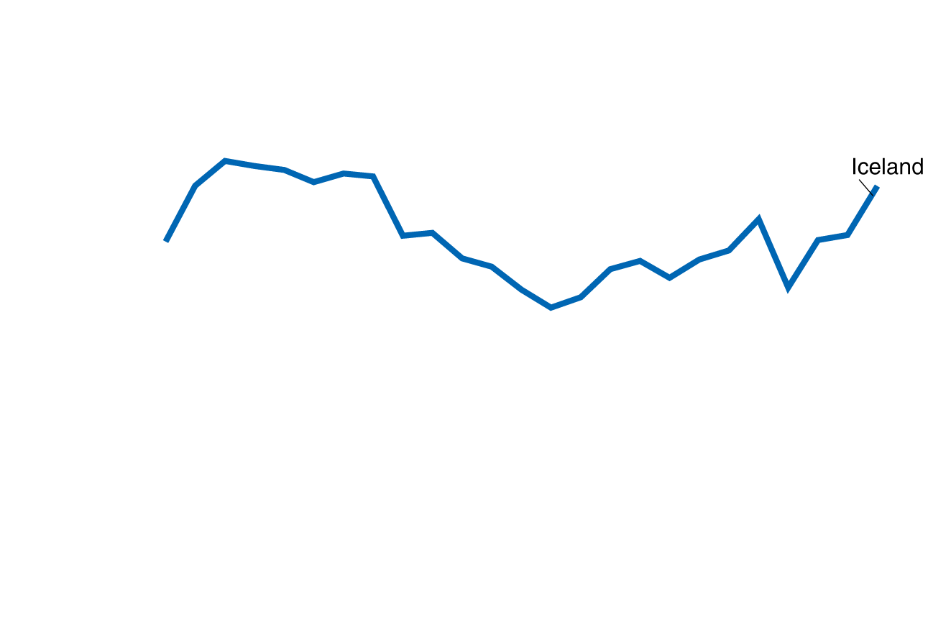
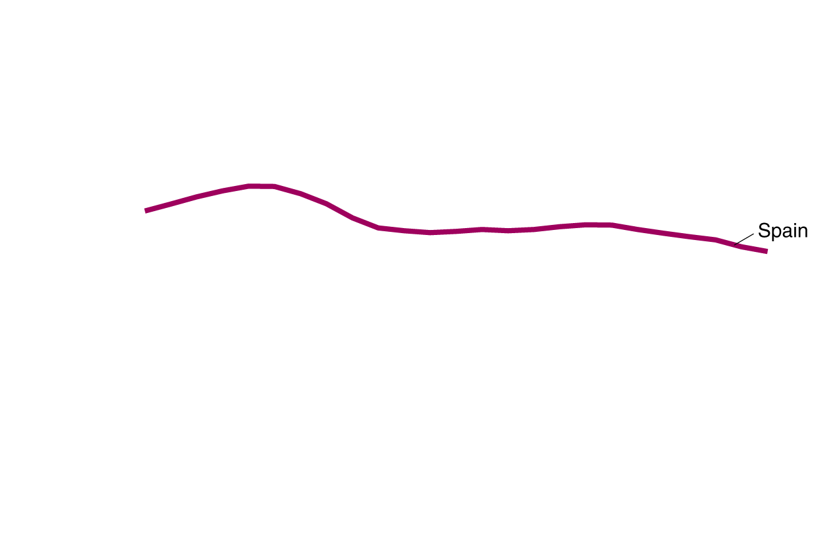
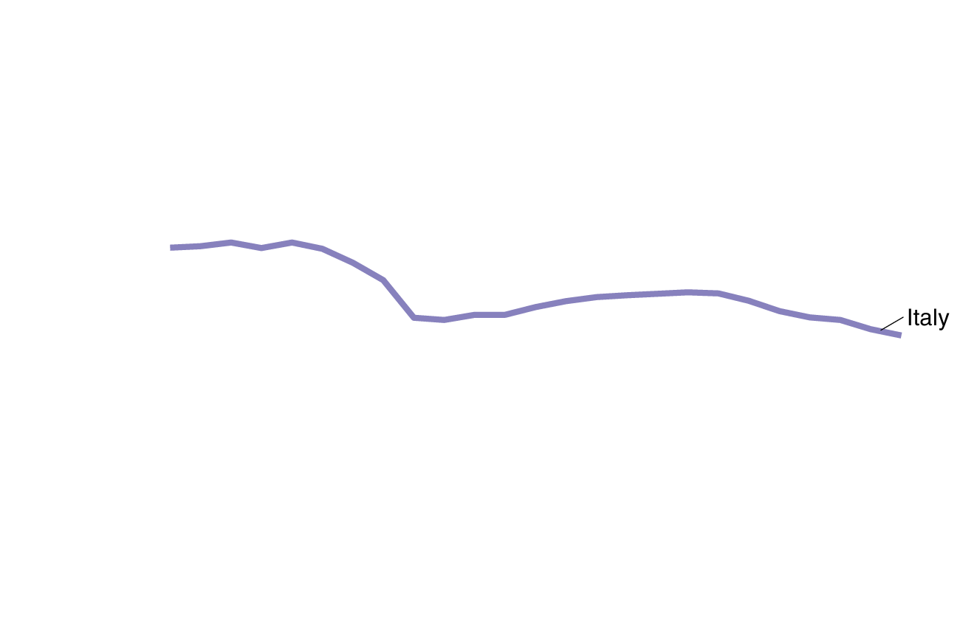
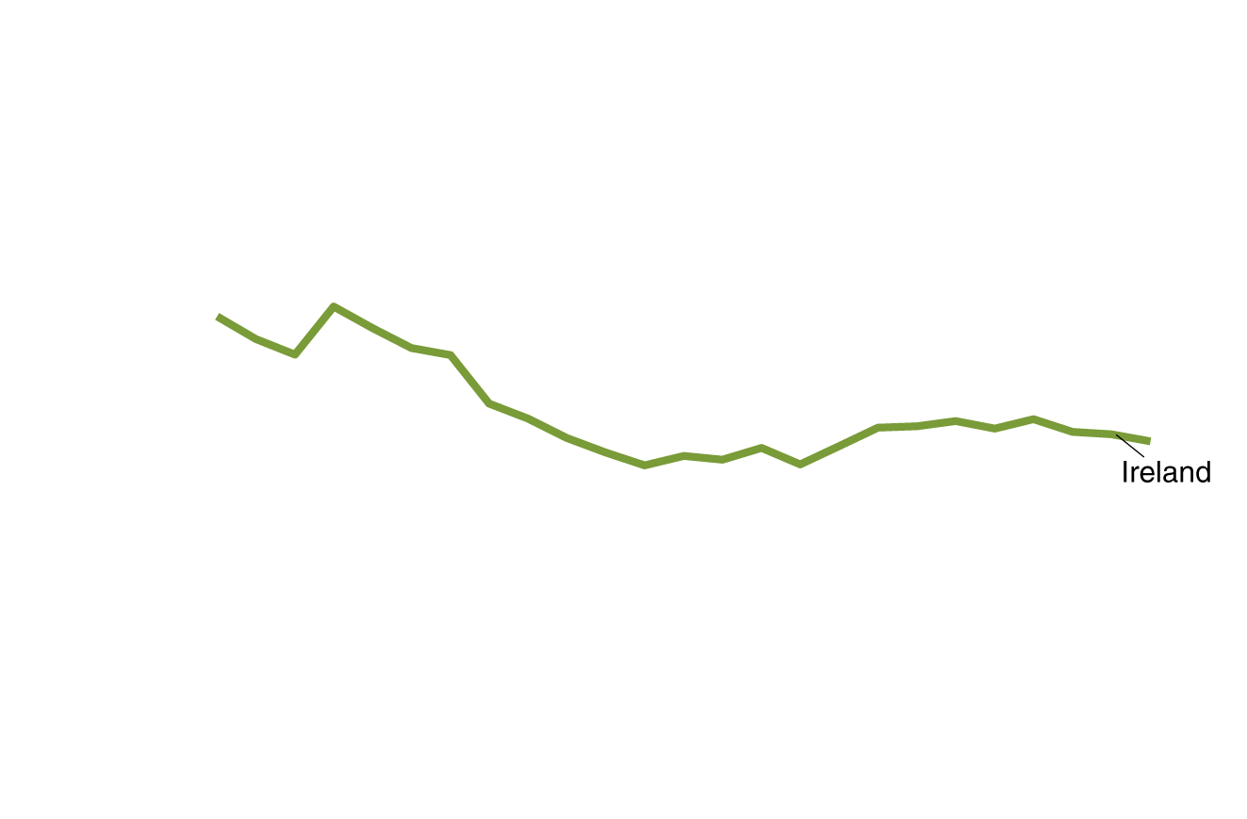
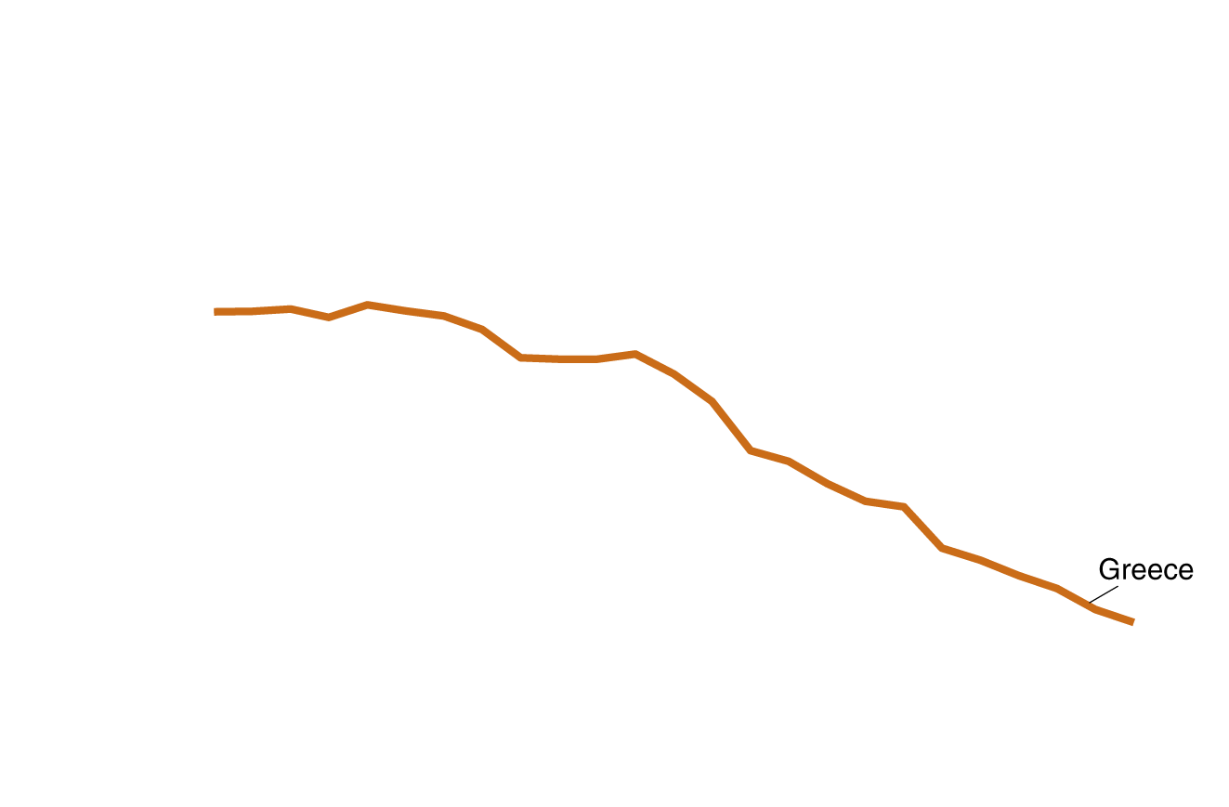
Why did Iceland recover so fast from the financial crisis?
The financial crisis caused strong declines in real GDP for many European countries.
Iceland was hit particularly hard, with real GDP falling 13% between 2007:Q3 and 2010:Q4.
But by 2012, Icelandic real GDP had returned to its pre-crisis levels, while other European countries continued their decline.

Slide 26
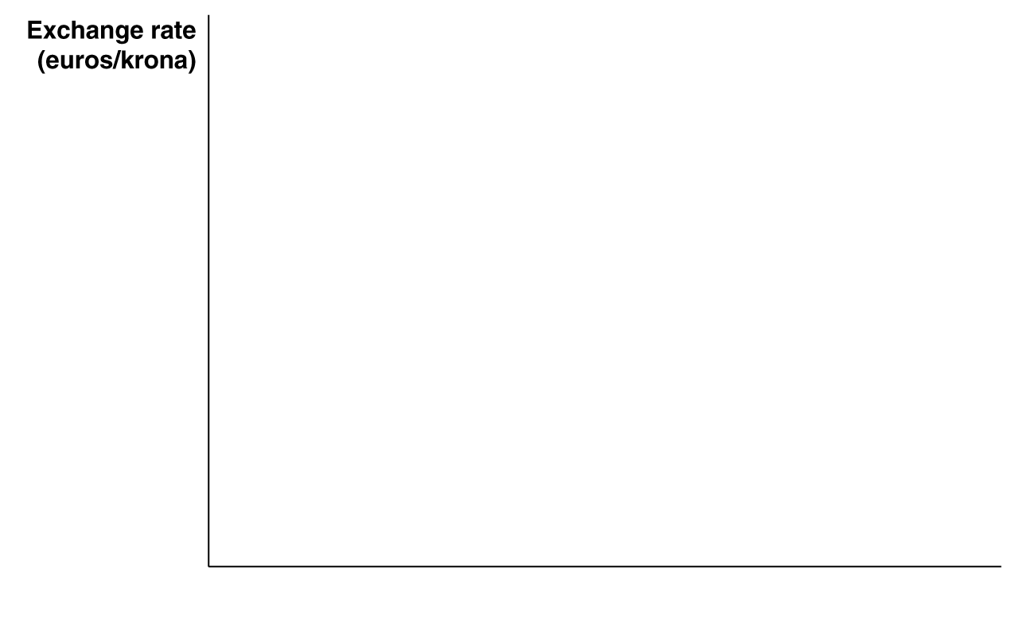
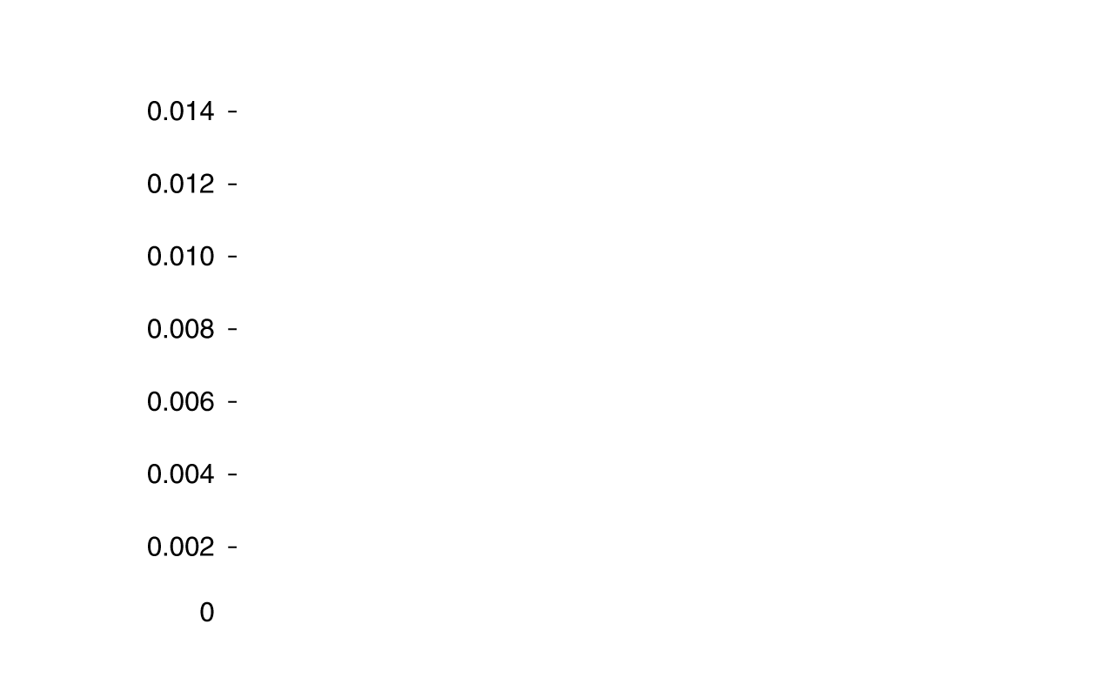
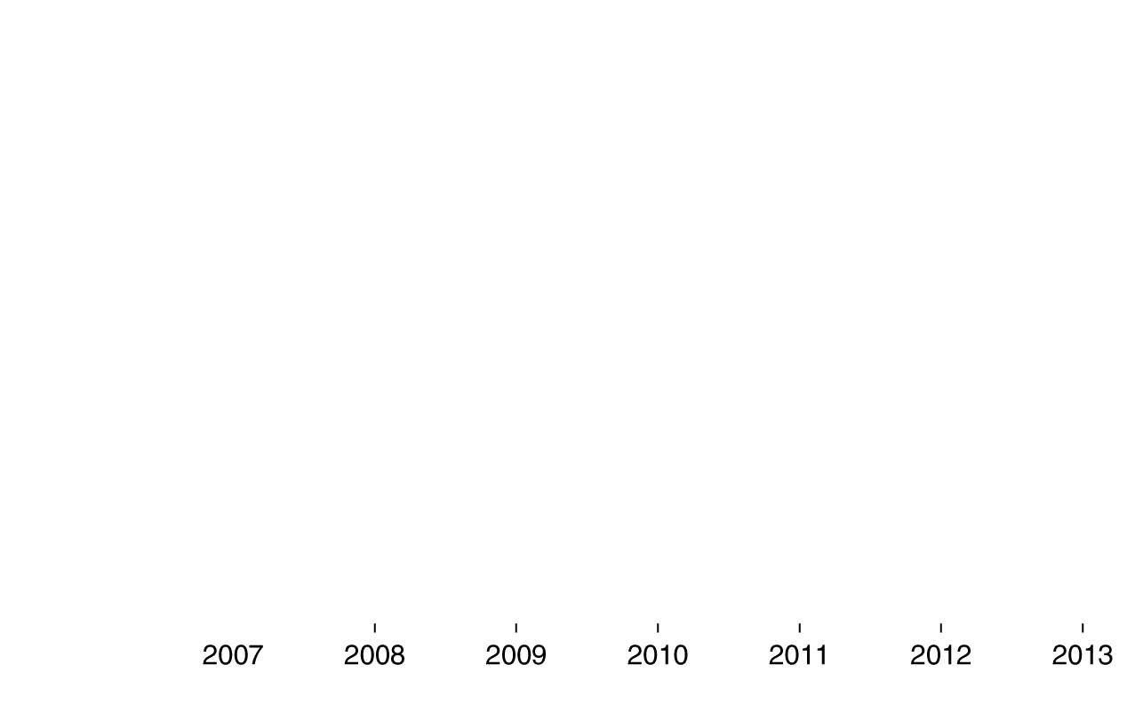
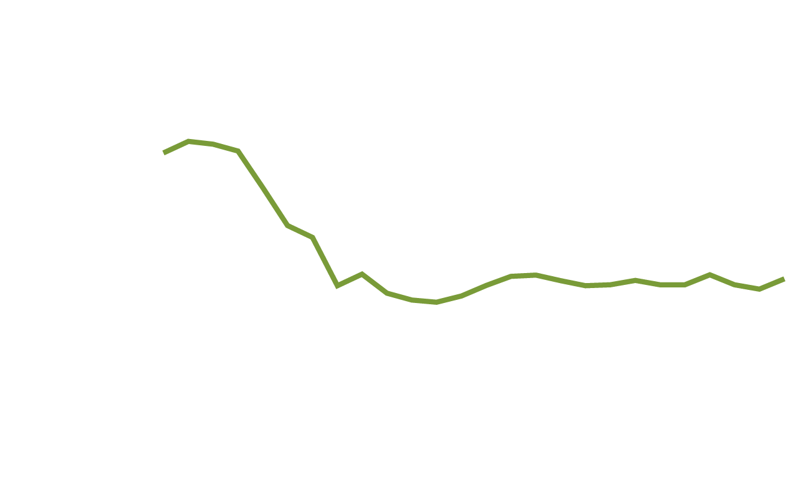
Why did Iceland recover so fast?—continued
Why did Iceland recover more quickly than other European countries?
One reason: Iceland does not use the euro; the krona was allowed to depreciate against the euro, spurring Iceland’s exports.
While the euro is useful for facilitating trade, Iceland’s experience shows that a flexible exchange rate can have important advantages.

Slide 27
International Capital Markets
19.3
Discuss the growth of international capital markets.

Slide 28
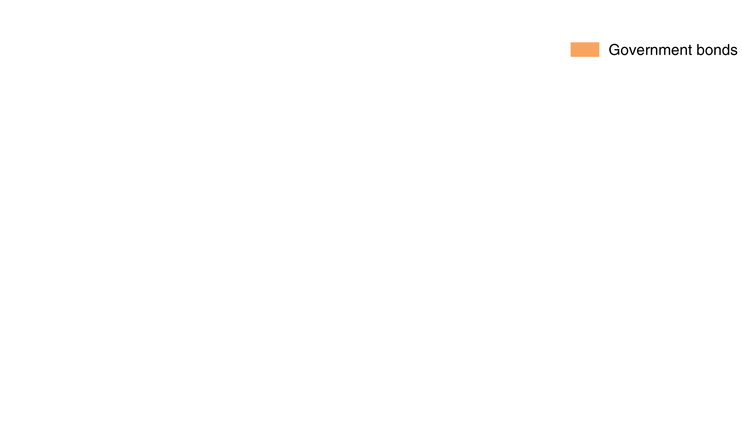





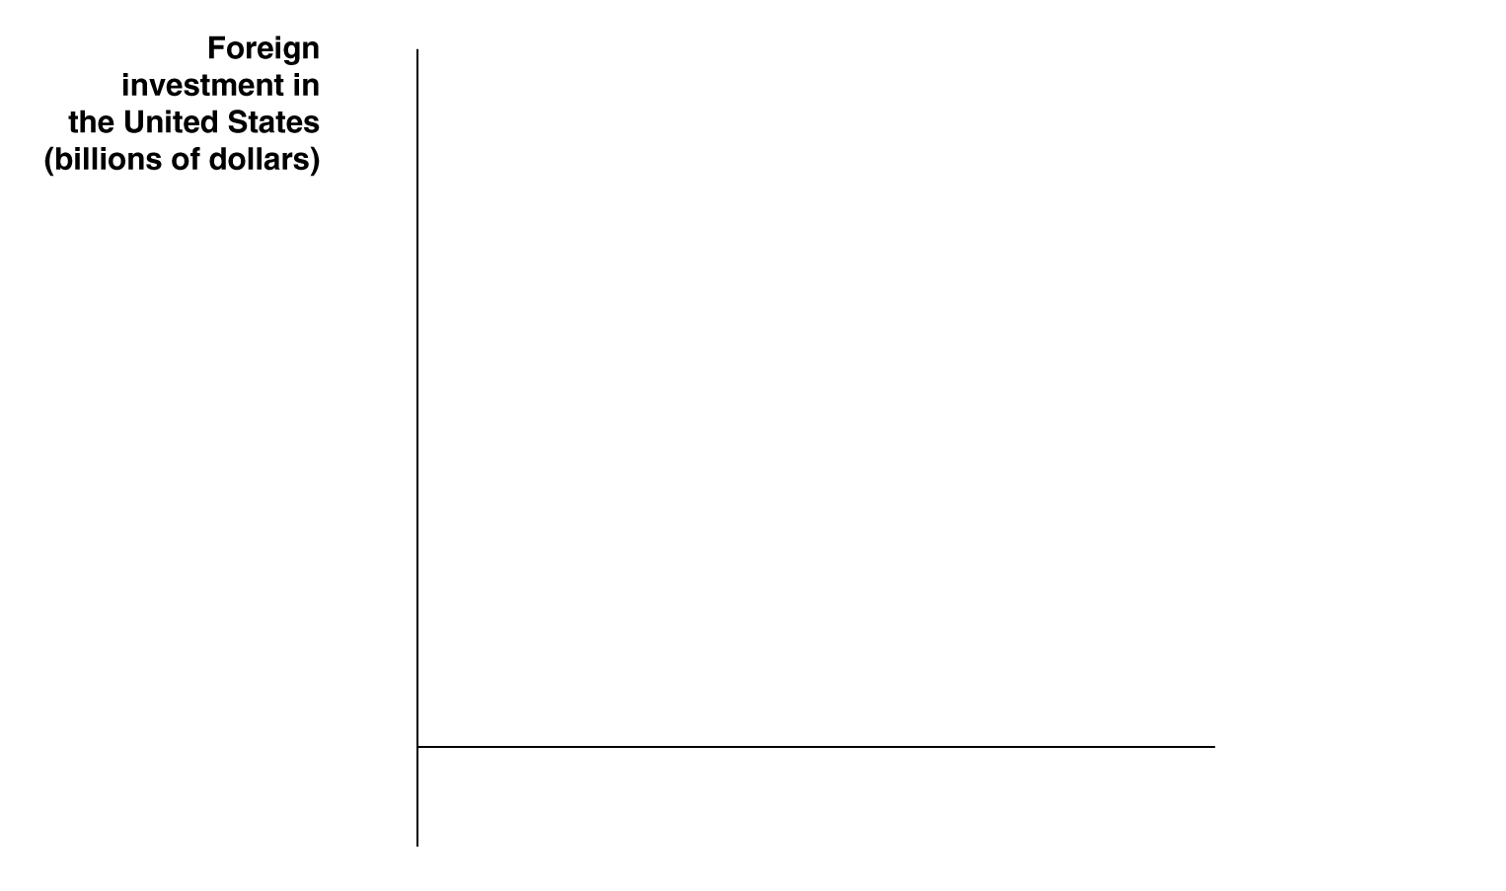
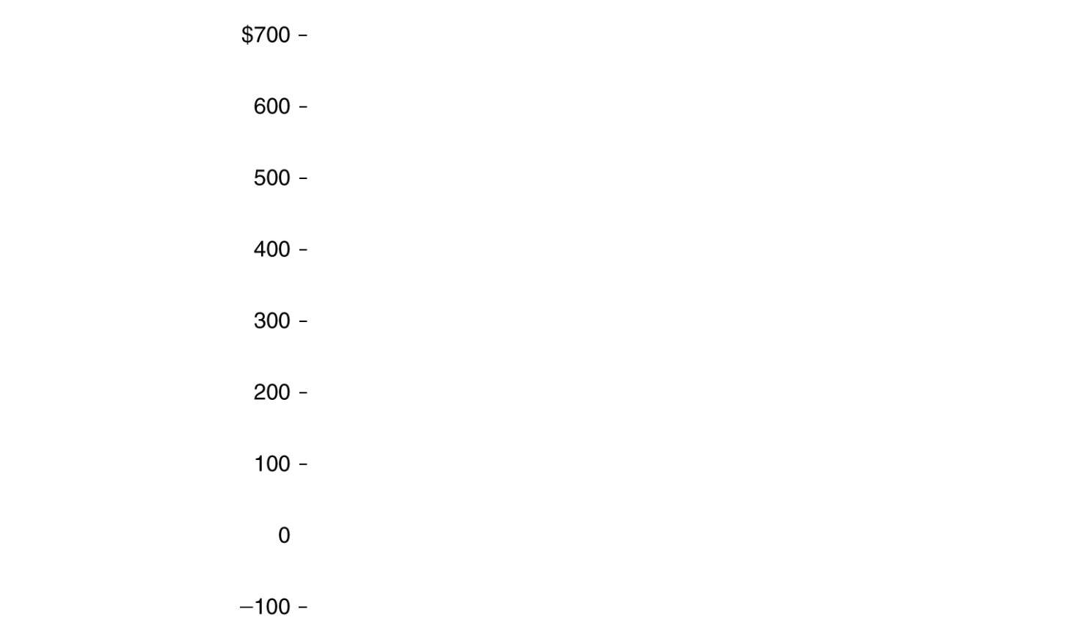
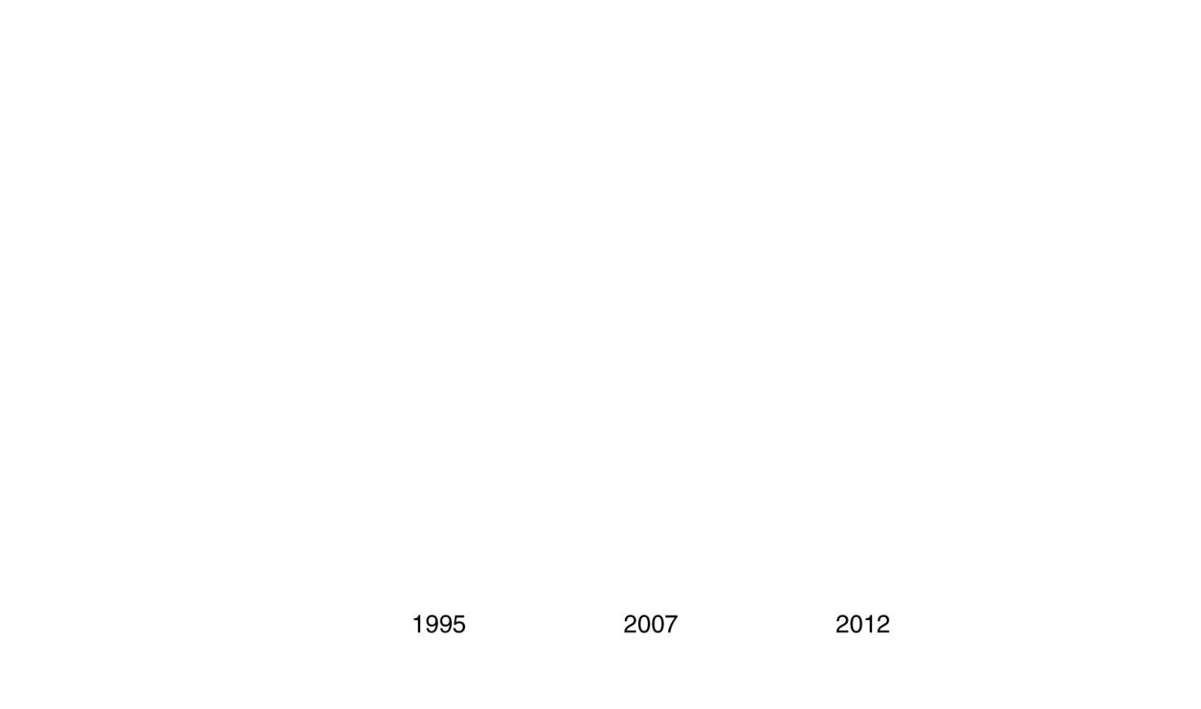
The rise of international capital markets
Before 1980, most U.S. corporations raised
funds only in U.S. stock and bond markets or from U.S. banks. Similarly, U.S. investors rarely invested in foreign markets.
In the 1980s and 1990s, legal restrictions on capital movement in Europe were lifted; and communication technology improved.
Figure 19.6
Growth of foreign portfolio investment in the United States
These changes made participating in international capital markets more practical and appealing; both for Americans, and for foreigners looking to invest in the U.S..
Notes:
Between 1995 and 2007, there was a large
increase in foreign purchases of stocks and
bonds issued by U.S. corporations and of
bonds issued by the federal government. In
2012, the slow recovery in the United States
from the 2007–2009 recession increased
the degree of risk that foreign investors saw
in holding these securities. Foreign purchases
of U.S. government bonds increased,
however.
Sources: International Monetary Fund,
International Capital Markets, August 2001;
and U.S. Department of the Treasury.

Slide 29






The rise of international capital markets—cont.
Through the 1990s,
there was a large
increase in foreign purchases of U.S. corporate stocks and bonds, and U.S. government bonds—foreign portfolio investments.
After the financial crisis, foreign purchases of U.S. government bonds soared, in a flight to safety from unstable European bond markets.
Figure 19.6
Growth of foreign portfolio investment in the United States
This demand was also fueled by U.S. current account deficits; foreigners with U.S. dollars needed to do something with the currency.

Slide 30
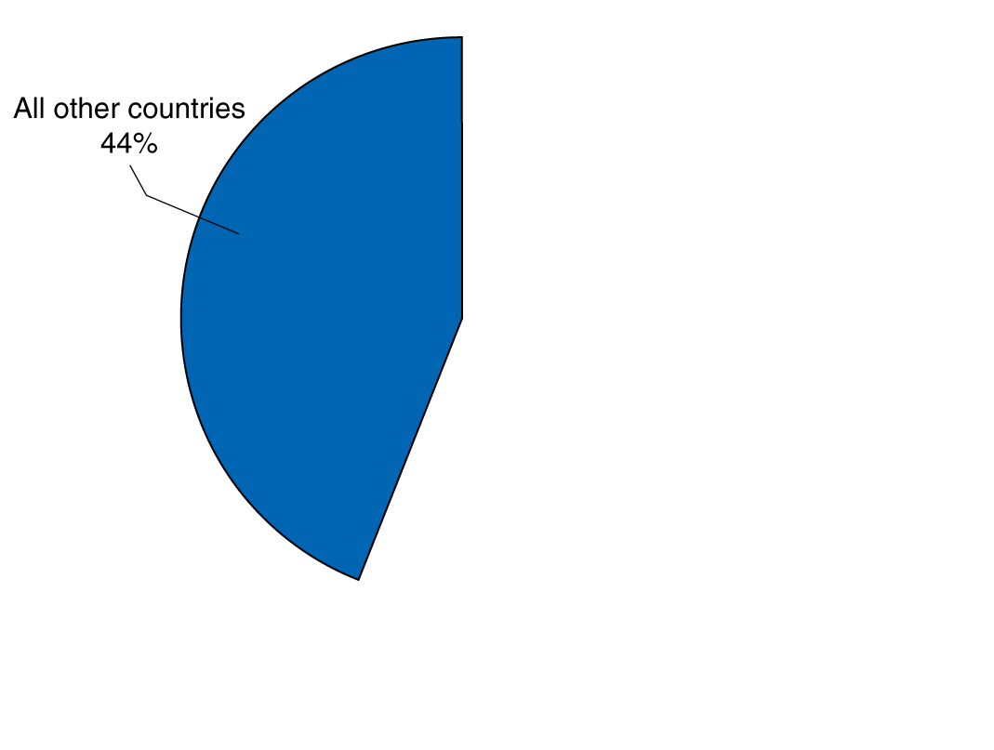
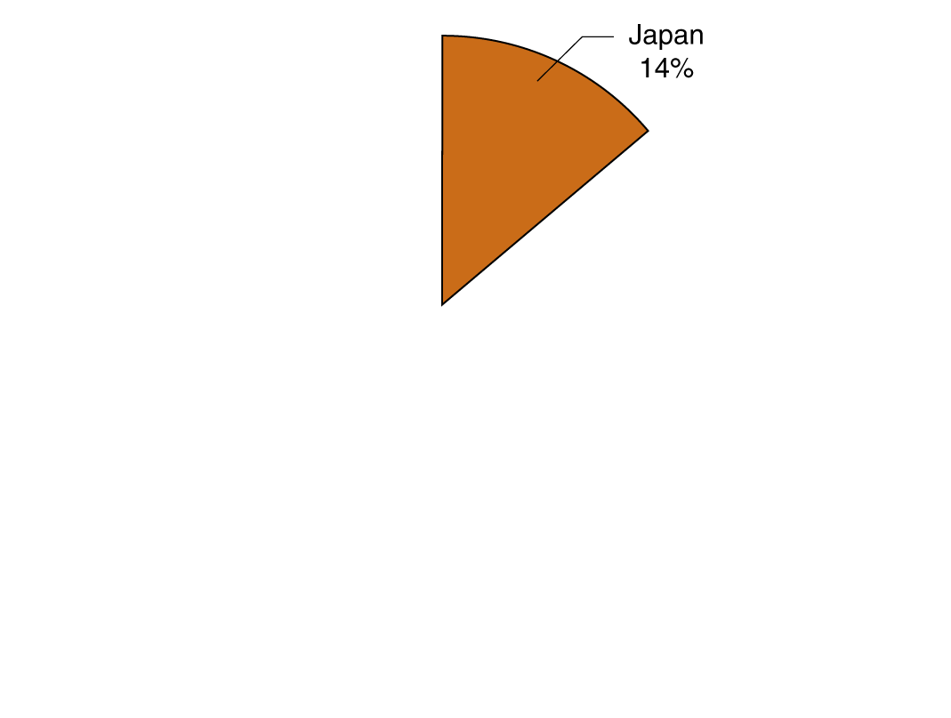
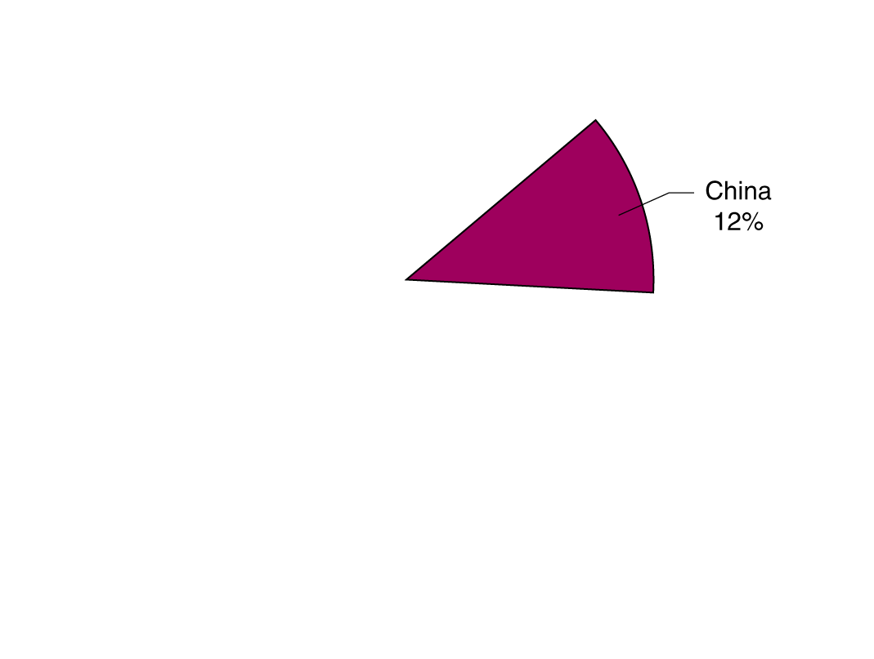
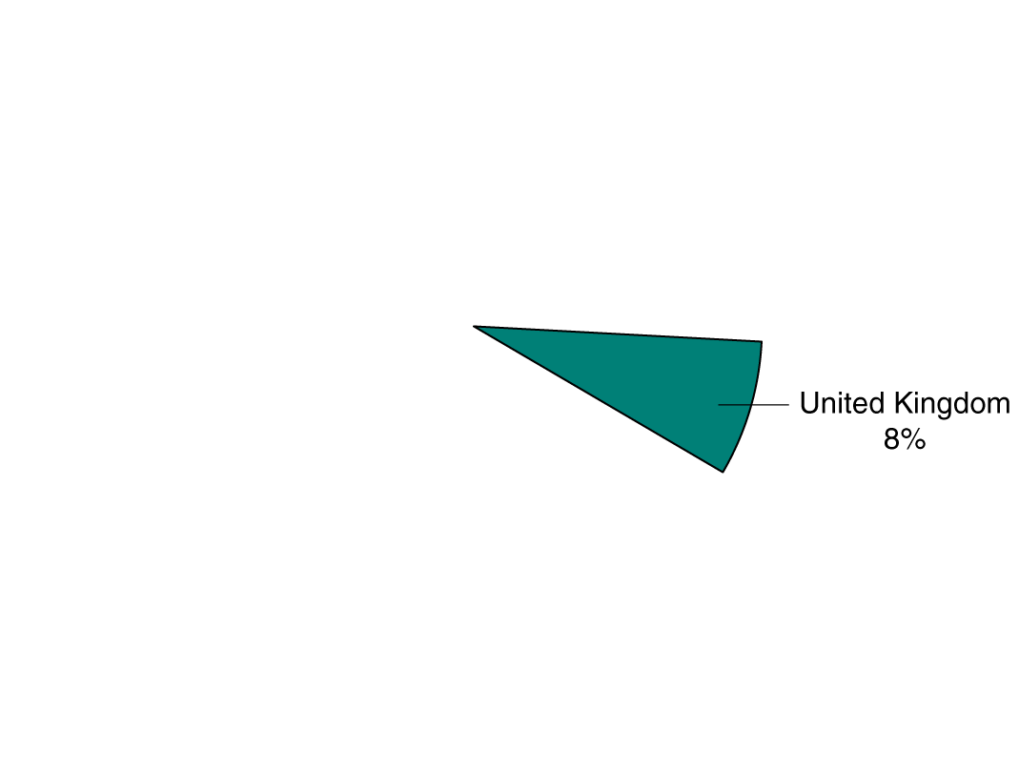
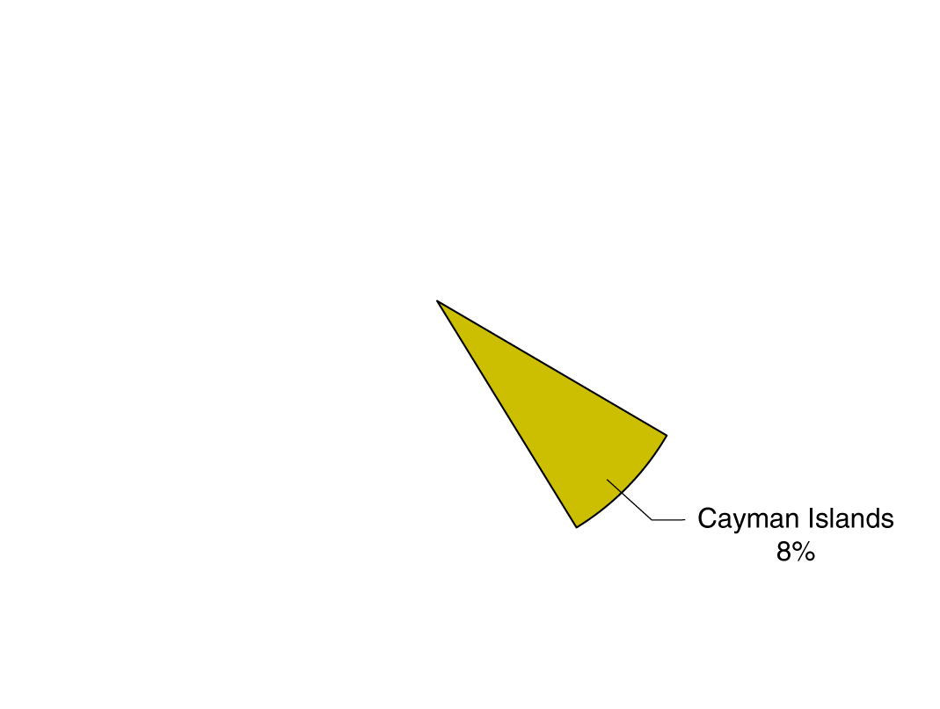
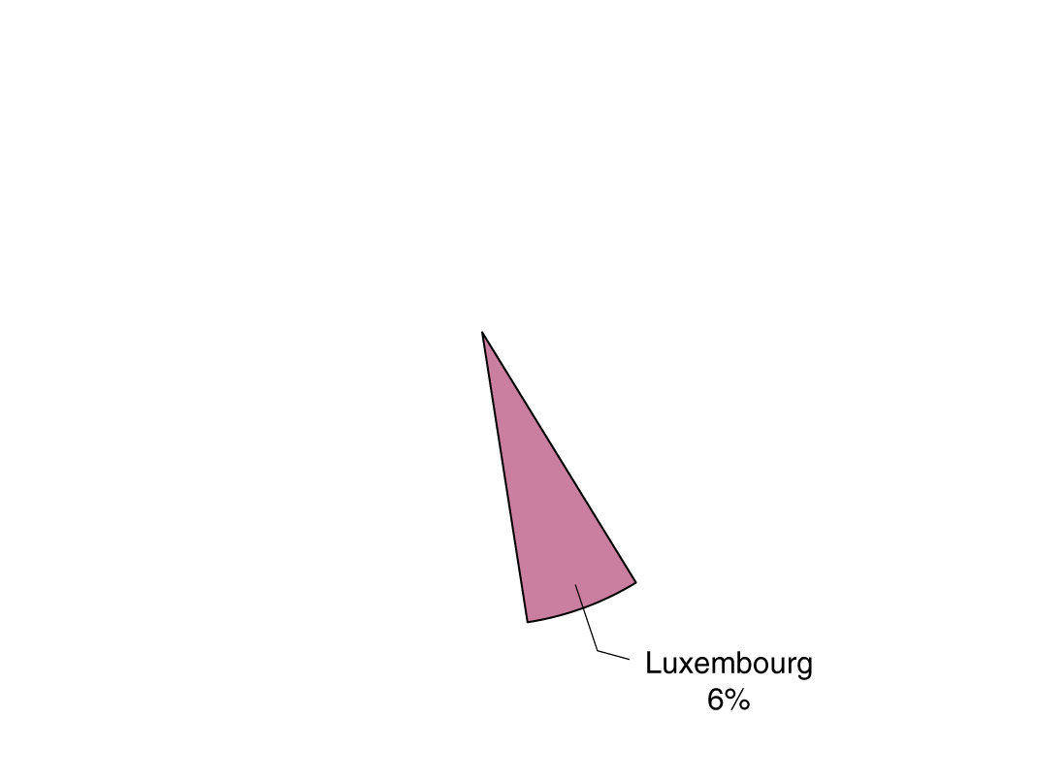
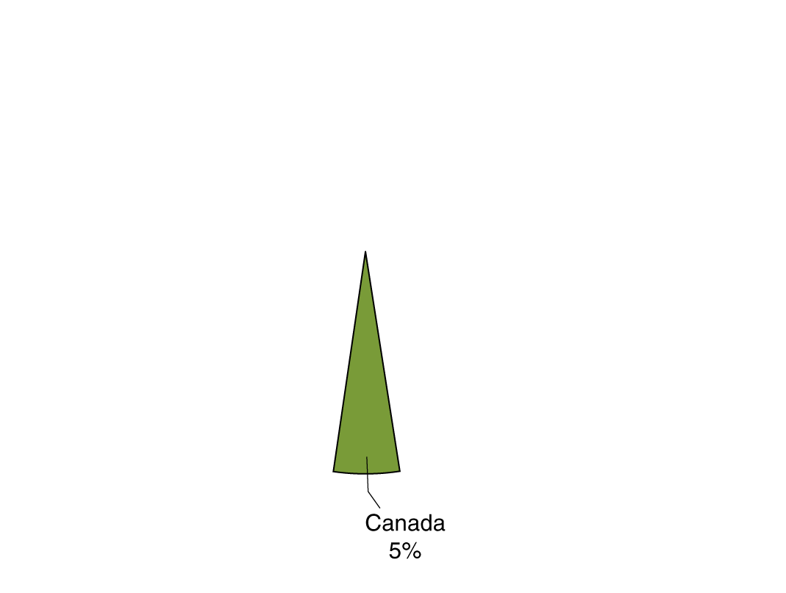
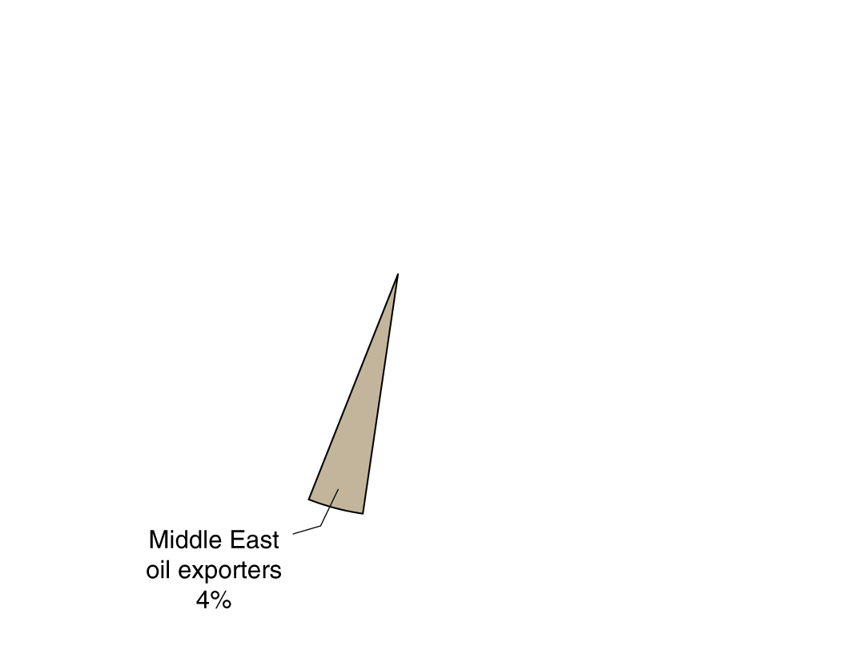
Foreign holdings of U.S. stocks and bonds, 2012
The globalization of financial markets has helped increase growth and efficiency.
Funds can be channeled to where they are most useful.
But the increased interconnectedness of financial markets also has a downside: shocks in one market are transmitted globally much faster than previously.
Figure 19.7
The distribution of foreign holdings of U.S. stocks and bonds by country, 2012
Notes:
Investors in China and Japan own about
one-quarter of foreign-owned U.S. stocks
and bonds.
Source: U.S. Department of the Treasury.

Slide 31
Common misconceptions to avoid
Modern currencies are not exchangeable for gold; they are fiat money, and have no value except as money.
An appreciation of the $US means that $1 can buy more foreign currency than before. That means the price of a unit of foreign currency has decreased.
Modern currencies do not truly float. Central banks influence exchange rates—some more than others.
Not all countries in Europe adopted the euro as their currency.

Slide 32
Appendix: The Gold Standard and the Bretton Woods System
Explain the gold standard and the Bretton Woods system.

Slide 33
The gold standard
Under the gold standard, a country’s currency consisted of
Gold coins, and
Paper currency that could be redeemed for gold
The U.K adopted the gold standard in 1816. Other countries followed, and by 1913, every country in Europe (except Spain and Bulgaria) and most in the Western Hemisphere) had followed.
Exchange rates were determined by how much gold each currency was worth. If $1 was worth 1/5 of an ounce of gold, an ounce of gold would cost $5. If £1 was worth one ounce of gold, then the exchange rate would be $5 = £1.

Slide 34
The end of the gold standard
Under the gold standard, a country could not control its own money supply; it depended on the supply of gold.
During wartime, countries would temporarily go off the gold standard, as the U.K did from 1914 to 1925.
1929: Great depression starts; countries on gold standard cannot fight it using expansionary monetary policy
1931: U.K. first major country to abandon gold standard
1933: U.S. follows suit
Late 1930s: last countries abandon gold standard
Countries that stayed on the gold standard longer suffered worse from the Great Depression, due to their inability to use expansionary monetary policy.

Slide 35
Tariffs and GATT
The 1930s also brought vastly increased tariffs; Smoot-Hawley Act of 1930 raised average U.S. tariffs to over 50%.
Other countries followed suit—the tariff wars.
International trade stagnated. In 1947, the U.S. and other major countries (excluding the Soviet Union) started participating in the General Agreement on Tariffs and Trade (GATT).
GATT led to sharp declines in tariffs
U.S. tariffs averaged <2% by 2011
1995: GATT replaced by World Trade Organization (WTO), with similar goals

Slide 36
The Bretton Woods system
1944: A conference held in Bretton Woods, NH established a new Bretton Woods system of exchange rates, under which countries pledged to buy and sell their currencies at a fixed rate against the dollar—and effectively against each others’ currencies.
The U.S., in turn, promised to redeem its currency for $35 per ounce—though only for foreign central banks; in fact, U.S. citizens were largely prohibited from owning gold from the 1930s until the 1970s.
Under Bretton Woods, countries held U.S. dollar reserves, and committed to exchanging their currencies for dollars at the given par exchange rates.

Slide 37
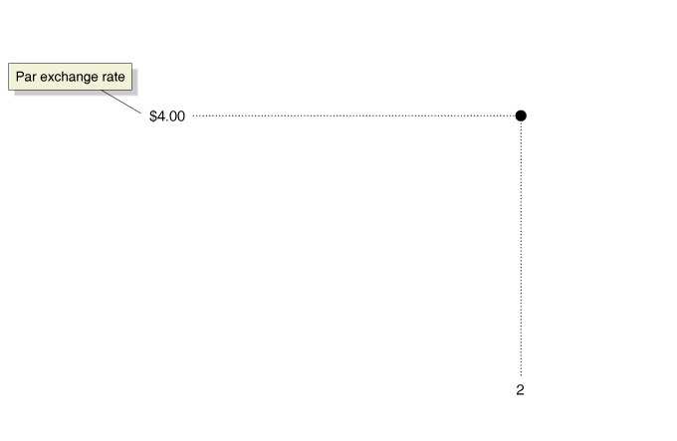
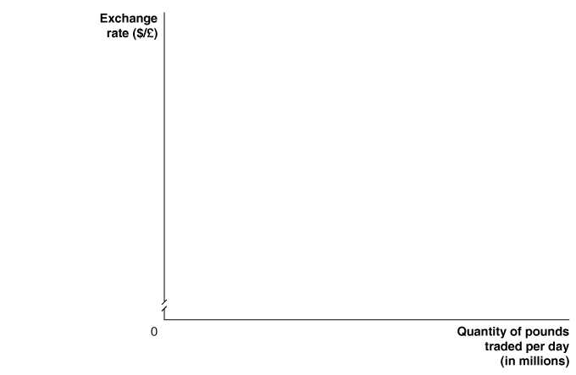

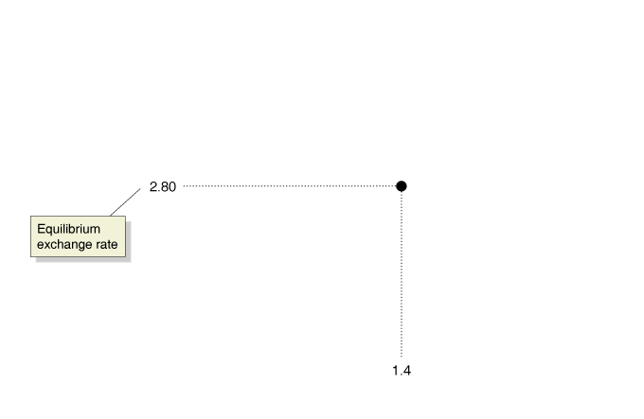

The International Monetary Fund (IMF)
If a central bank ran out of dollar reserves, it could borrow them from the newly created International Monetary Fund, which also oversaw the operation of the international monetary system.
For example, if the par exchange rate were $4 = £1, then if the demand for pounds was too low, the Bank of England promised to make up the demand, selling its $US reserves.
Eventually, it would run out of $US reserves.
Figure 30A.1
A fixed exchange rate above equilibrium results in a surplus of pounds
Notes:
Under the Bretton Woods system, if the par
exchange rate was above equilibrium, the
result
would be a surplus of domestic currency
in the foreign exchange market. If the
par exchange rate was below equilibrium,
the result would be a shortage of domestic
currency. In the figure, the par exchange rate
between the pound and the dollar is $4 = £1,
while the equilibrium exchange rate is $2.80
= £1. This gap forces the Bank of England to
buy £1 million per day in exchange for dollars.

Slide 38
Devaluation and revaluation
If such a surplus persisted, it would be seen as evidence of fundamental disequilibrium in a country’s exchange rate.
When the IMF agreed that a currency was over-valued, there would be a devaluation, or reduction in the fixed exchange rate.
An under-valued currency would have its par exchange rate increased—a revaluation.

Slide 39





Problems in the Bretton Woods system
By the late 1960s, the total number of dollars held by foreign banks exceeded the gold supply of the U.S., bringing the credibility of the system into question.
Also, some countries with under-valued currencies refused
to revalue, since
that would make their exports more expensive.
West Germany was the most important country in this situation; it had to continually supply more marks in order to buy U.S. dollars.
Figure 30A.2
West Germany’s undervalued exchange rate
Notes:
The Bundesbank, the German central bank,
was committed under the Bretton Woods
system to defending a par exchange rate of
$0.27 per deutsche mark (DM). Because this
exchange rate was lower than what the equilibrium
market exchange rate would have
been, there was a shortage of DMs in the
foreign exchange market. The Bundesbank
had to supply DMs equal to the shortage in
exchange for dollars. The shortage in the figure
is equal to 1 billion DMs per day.

Slide 40
Inflation fears in West Germany
After WWI, Germany had suffered devastating hyperinflation; and there were fears that the continually increasing West German money supply would lead to inflation.
Since this was politically untenable, investors became convinced the exchange rate must be revalued.
Figure 30A.2
West Germany’s undervalued exchange rate

Slide 41





Destabilizing speculation against the Deutsche mark
During the 1960s, capital controls (limits on the flow of foreign exchange and financial investment
across countries) had been reduced in Europe.
Figure 30A.3
Destabilizing speculation against the Deutsche mark, 1971
This allowed investors, who were convinced the mark would be revalued, to increase speculative purchases. In May 1971, it became too difficult to maintain the exchange rate, and West Germany allowed the mark to float.
By 1973, the whole Bretton Woods system had collapsed.
Notes:
In 1971, the par exchange rate of $0.27 = 1 deutsche mark was below the equilibrium
exchange rate of $0.35 = 1 deutsche mark. As investors became convinced
that West Germany would have to revalue the deutsche mark, they increased their
demand for marks, shifting the demand curve from D1 to D2. The new equilibrium
exchange rate became $0.42 = 1 deutsche mark. This increase in demand
raised the quantity of marks the Bundesbank had to supply in exchange for dollars
to defend the par exchange rate from 1 billion deutsche marks to 2 billion
deutsche marks per day.

